Slide 1
Covid-19 Infection Rates by Zip Code
Group 7

Slide 2
Overview
Datasets: Combining infection rates with 2018 Census data
New York City, sourced from the the city's Department of Health
Chicago, sourced from Illinois Department of Health
Detroit, sourced from the city's COVID-19 ZIP code dashboard
Philadelphia, sourced from the Pennsylvania Department of Health
Baltimore, sourced from the Maryland Department of Health

Slide 3
Previous Work
Similar research was done in the Buzzfeed News article “These ZIP Code–Level Maps Show The Places Hit Hardest By COVID-19” that focuses on specific correlations such as:
Average Household Size vs. Cases Per 1,000
Percentage of Service Workers vs. Cases Per 1,000
Median Household Income vs. Cases Per 1,000
Percentage of Minority Residents vs. Cases Per 1,000
We are building off this work by using the same combined dataset and adding in more zip codes and looking at different variables correlation and looking at the possibility of prediction for covid-19 infection rates

Slide 4
Question and Motivation
Question: Is it possible to predict infection rates for zip codes in major cities?
Motivation: Although vaccines have been created and infection rates and mortality for Covid-19 are significantly lower, any information we find has the potential to be applied to future variants or similar diseases

Slide 5
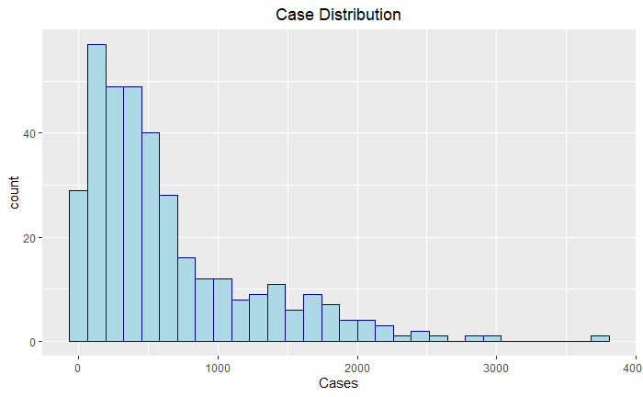
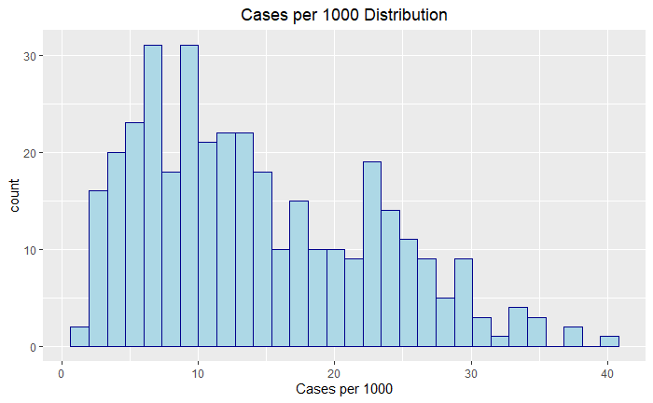
Target Variable

Slide 6
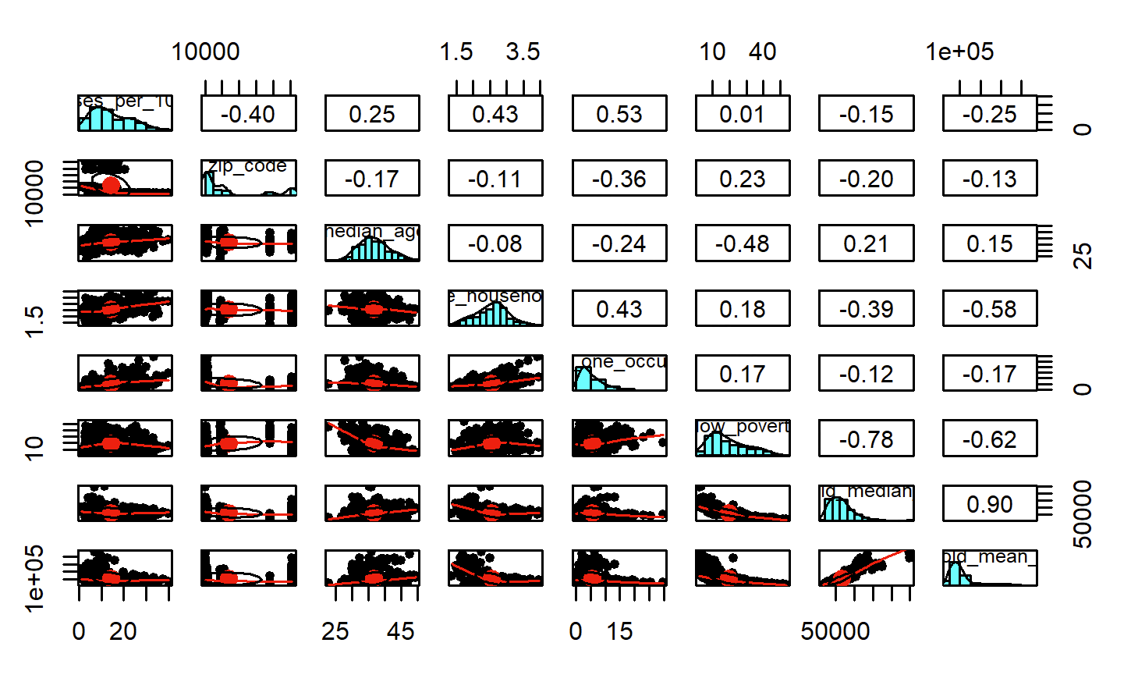
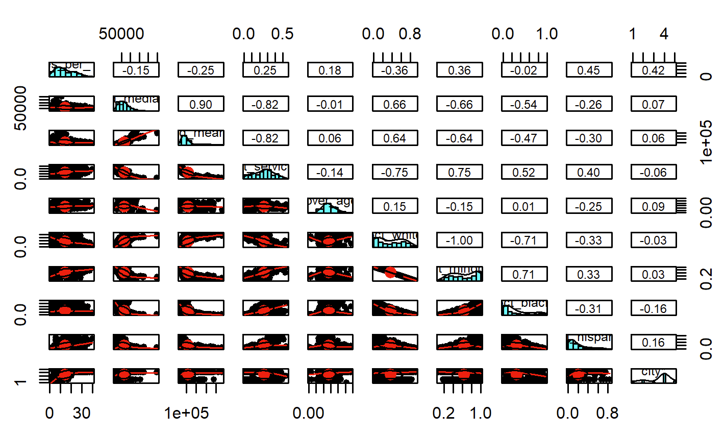
Scatter Plots and Correlation Coefficients
Percent minority and city
Zip Code, average household size, percent with more than one occupant in room

Slide 7
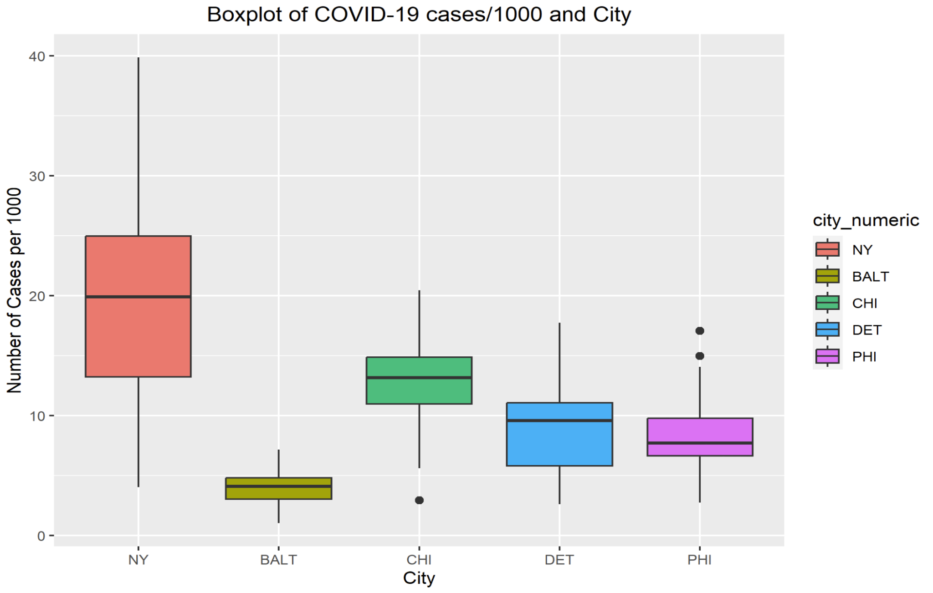
Cases Breakdown by City

Slide 8
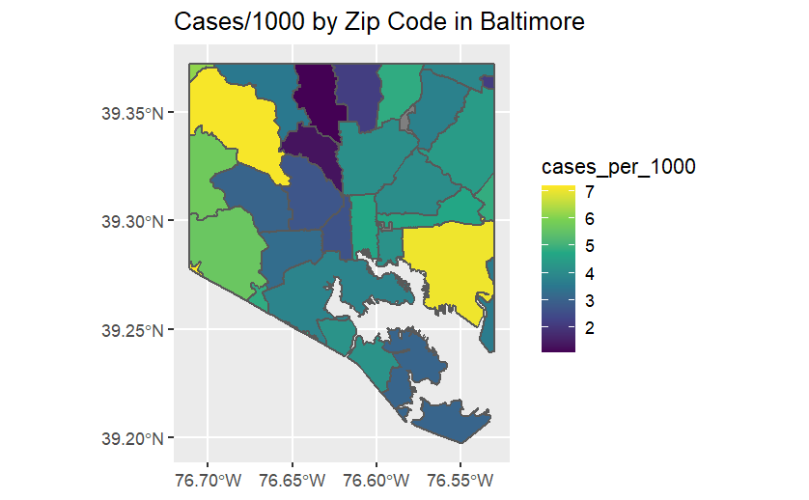
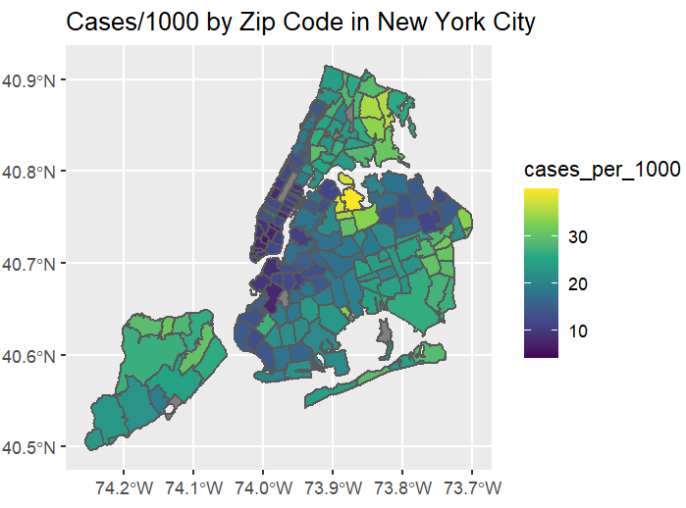
Zip Map: Cases per 1000

Slide 9
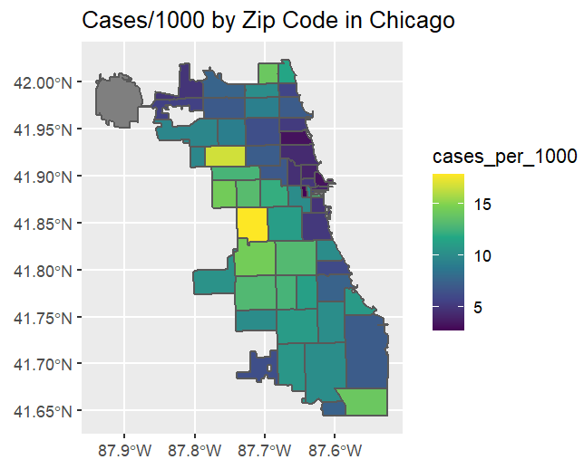

Slide 10
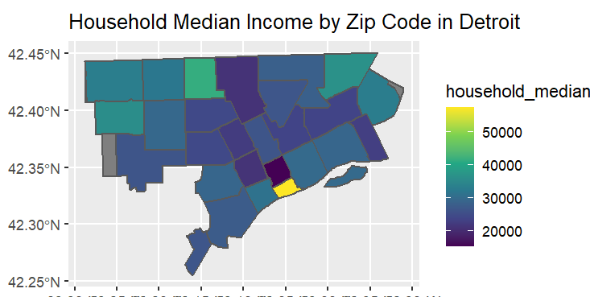
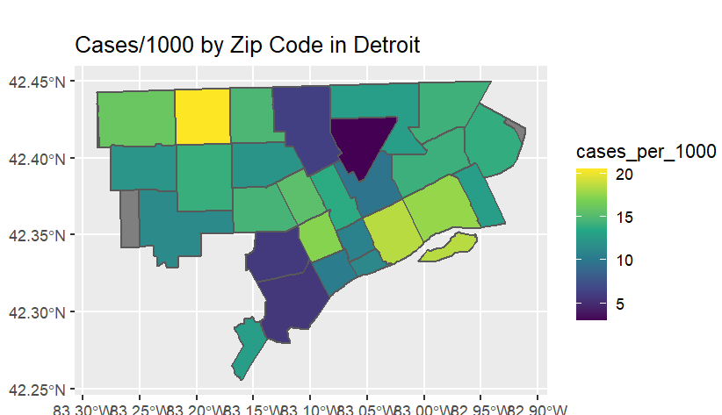

Slide 11
Models Using Cases per Thousand
Model 1: LASSO Regression
Model 2: Ridge Regression
Model 3: Linear Stepwise Regression
- Least Absolute
Shrinkage and Selection Operator
- Aims to minimize sum of squared residuals for predicted and actual values while adding a penalty for magnitude regression coefficients
NRMSE: .59596
- Typically used when independent variables are highly correlated
-Addresses issue of collinearity by adding penalty to the regression coefficients, prevents overfitting
NRMSE: .5973
-Uses Maximum likelihood estimation
-Models the relationship between a dependent variable representing counts and one or more independent variables
NRMSE: .60
Adjusted - R Squared: .5346

Slide 12
Binning Cases Per Thousand Data into Risk Levels
Binned Cases Per 1000 into 3 different levels
1 Low Risk: 0-15.5
2 Medium Risk: 15.5-23
3 High Risk: 23 +
Ran a decision tree and multinomial model to predict risk category

Slide 13
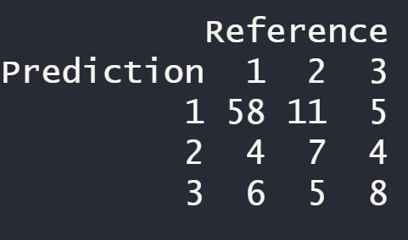
Decision Tree Performance
Accuracy : 0.6759
95% CI : (0.5791, 0.7628)

Slide 14
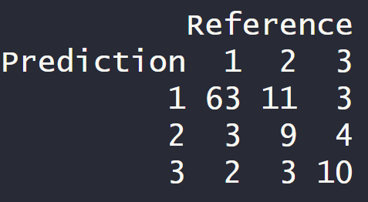
Multinomial Model Performance
Accuracy: 0.7593
95% CI: (0.6675, 0.8363)

Slide 15
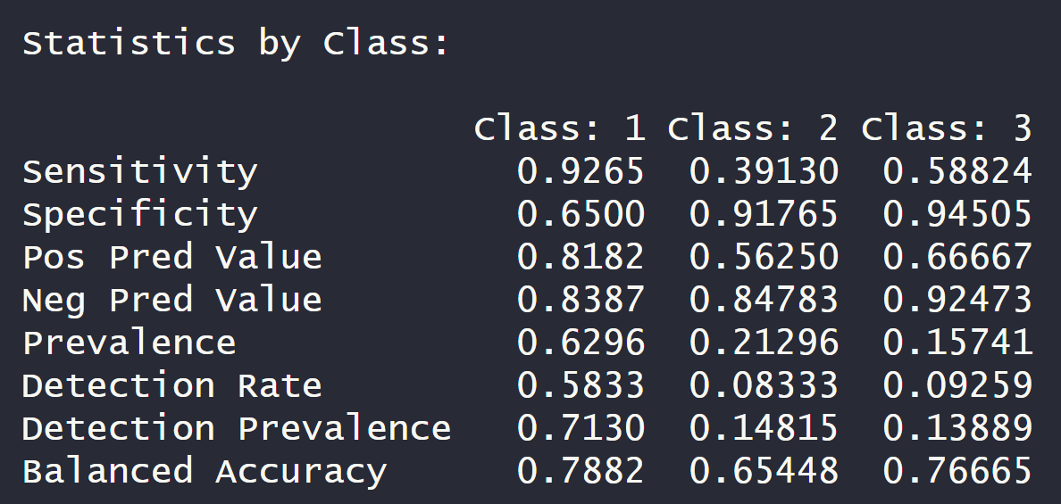
Multinomial Model Performance by Class
Class 2 and Class 3 have low sensitivity
Class 2 and 3 have high specificity (false positive metric)

Slide 16

Conclusion
Predicting the rate/number of cases was not successful
When binning the data, the multinomial model performed the best with a 76% accuracy
However a lot of work to do to improve accuracy and minimize false negatives

Slide 17

Next Steps
Analyze ways to focus on improving performance of class 2 and 3
Look at other metrics for assessing models (precision, ect.)
Add in more zip codes to add in rural areas to prediction
Adding in additional demographic variables such as education status or prior illness
Somehow weight areas with more immune compromised higher

Slide 18
Shiny App Demo!

Slide 19
Citations
BuzzFeedNews. (n.d.). BuzzFeedNews/2020-05-covid-city-zip-codes: Data, code, and methodology supporting the BuzzFeed News’ analysis of Covid-19 ZIP Codes and demographic trends. GitHub. https://github.com/BuzzFeedNews/2020-05-covid-city-zip-codes
Multinomial Logistic Regression - Statistics Resources - LibGuides at Northcentral University (nu.edu)
https://www.datacamp.com/tutorial/tutorial-lasso-ridge-regression#:~:text=Similar%20to%20the%20lasso%20regression,referred%20to%20as%20L2%20Regularization.
O'Reilly for Higher Education - O'Reilly Media (oreilly.com)

